Slide 1

Computer Engineering Department
A.P. Shah Institute of Technology
G.B.Road,Kasarvadavli, Thane(W), Mumbai-400615
UNIVERSITY OF MUMBAI
Academic Year 2019-2020

Slide 2
A Project Report on
Artificial Teaching Assistant
Submitted in partial fulfillment of the degree of
Bachelor of Engineering(Sem-7)
in
Computer Engineering
By
Nirish Samant(16102008) Akshay Sumbhe(16102062)
Tarakeshwarnath Sahani(16102033)
Under the Guidance of
Prof.Sachin Takmare

Slide 3
1.Project Conception and Initiation

Slide 4
1.1 Abstract
It is an Artificial Teaching Assistant that has been developed with main aim to assist teachers in their teaching process.
It is designed to work for english language although it might work on some other language depending on the nature of the language, the structure, grammar and semantics.
This project i.e. Artificial Teaching Assistant is as the name implies is the program developed for teaching assistance by using various techniques from artificial intelligence and image processing in order to reduce the teaching efforts in many auxiliary but time consuming teaching tasks so that teachers can focus more on the core knowledge teaching aspects.

Slide 5
1.2 Objectives
As educational AI progresses and becomes more sophisticated, it’s essential to include teachers in the process. In an ideal world, teachers and AI will create an immersive learning experience for students, together.
Develop the AI programs to do many auxiliary teaching tasks like improving the quality of available images and notes, automatically corrects the spellings in the document, grammer correction, auto answering the key questions on the given contents, sentiment analysis, text summarization etc.

Slide 6
1.3 Literature Review
We referred various books and papers to understand various concepts related to Artificial Intelligence, Image Processing ,
Signal Processing , Machine Learning etc
Some of the books are :
1) Digital Image Processing by Rafel C. Gonzalez and Richard E. Woods
2) Digital Image Processing by S. Sridhar
3) Speech and Language Processing by Daniel Jurafsky and James H. Martin
4) Foundations of Statistical Natural Language Processing by Christopher D.Manning and Hinrich Schutze
5) Natural Language Processing with Python by Steven Bird and Ewan Klein
6) Artificial Intelligence A Modern Approach , Stuart J. Russell and Peter Norvig
7) Artificial Intelligence and Intelligent Systems , N.P.Padhy
8) Neural Networks, Fuzzy Logic and Genetic Algorithms , S.Rajasekaran and G.A. Pai
9) Fuzzy Set Theory and its Applications , Zimmermann
10) Digital Signal Processing John G. Proakis, Dimitris and G.Manolakis
11) Digital Signal Processing , A. Anand Kumar
12) Artificial Intelligence , Elaine Rich and Kevin Knight

Slide 7
1.5 Scope
The different AI techniques available like natural language processing, image processing will be used to perform these tasks.
Image processing technique is used for improving image quality in the available teaching material.
Teaching notes prepared can be checked for spelling and grammar. NLP techniques are used for developing the program code to these tasks.
The feedbacks received from students for any lecture can be analysed by the sentiment analysis program. Attempt has been made to develop an sentiment analysis program to perform aspect level of teaching staff feedback.
Text summarisation program will automatically condense the important information in the form of summary which would benefit the teachers.

Slide 8
1.6 Technology stack
Python
Python is an interpreted, high-level, general-purpose programming language.Its language constructs and object-oriented approach aim to help programmers write clear, logical code for small and large scale projects.
Open CV
OpenCV (Open source computer vision) is a library of programming functions mainly aimed at real time computer vision. The library is cross-platform and free for use under the open source BSD license.
NLTK
The Natural Language Toolkit, or more commonly NLTK, is a suite of libraries and programs for symbolic and statistical natural language processing for English written in the Python programming language. NLTK is a leading platform for building Python programs to work with human language data..

Slide 9
1.7 Benefits for environment & Society
Reduced Carbon Footprint
Access to Documents from Everywhere
Keeps Things Simple
Reduced Costs
Increased output and productivity
Increased quality
Reliability

Slide 10
2. Project Design

Slide 11
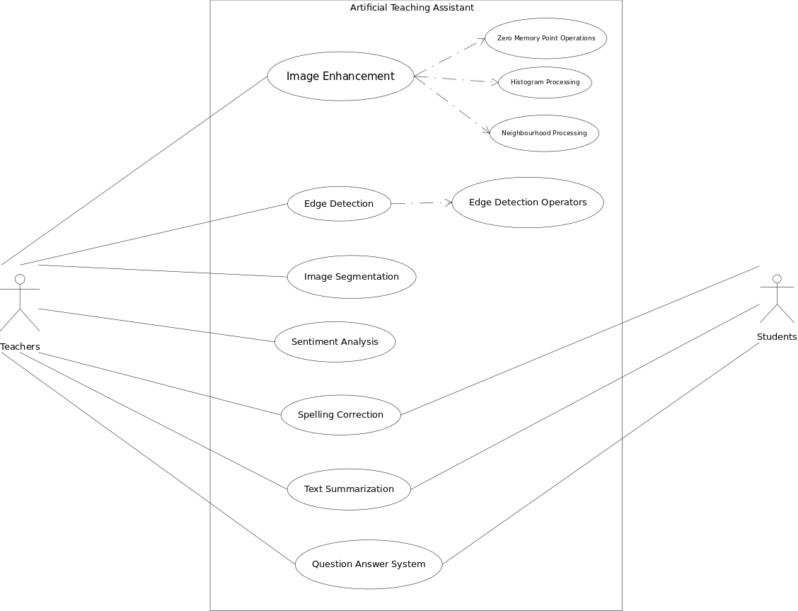
Use Case Diagramn

Slide 12
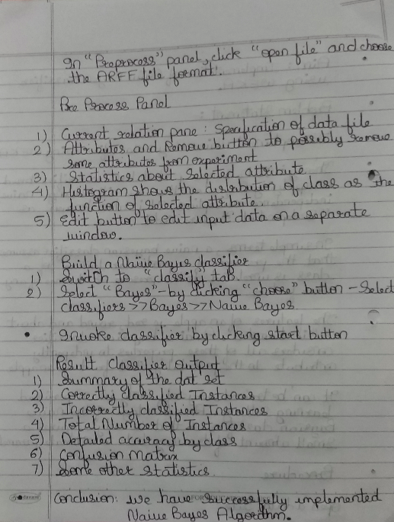
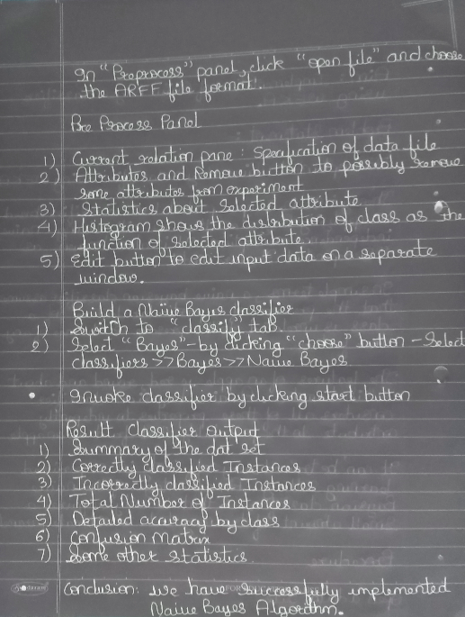
Digital Negative / Inversion

Slide 13
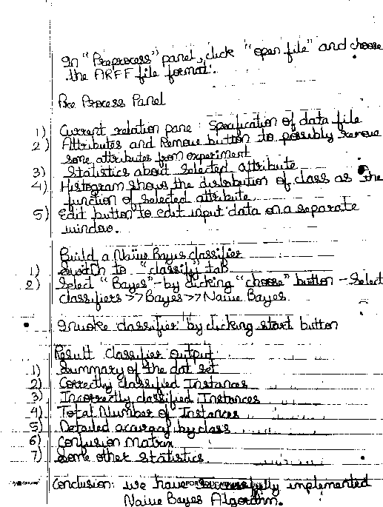
Thresholding

Slide 14
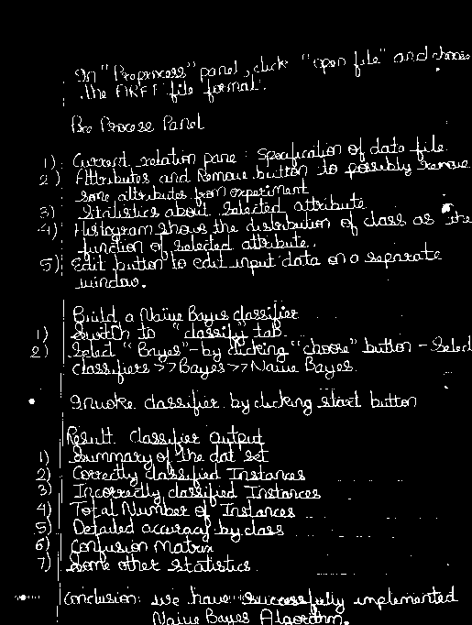
Intensity Level Slicing without Background

Slide 15
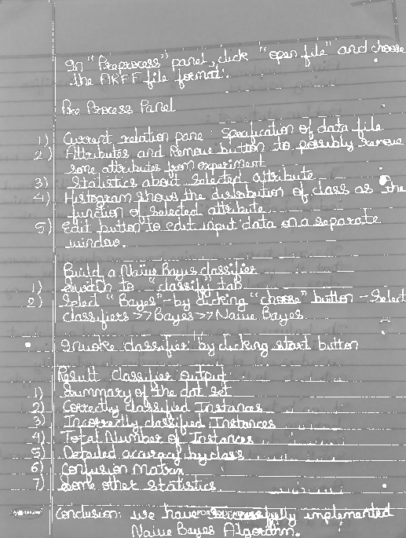
Intensity Level Slicing with Background

Slide 16









Bit Plane Slicing

Slide 17
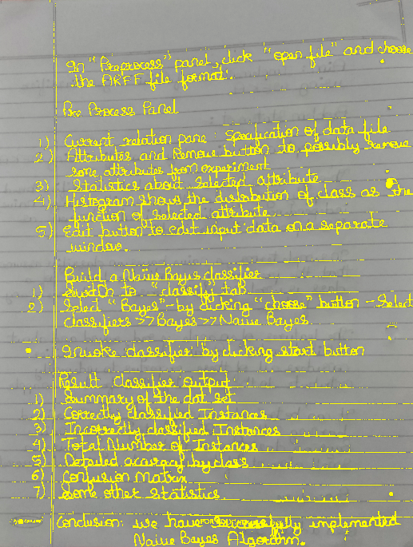
Image Text Colouration

Slide 18
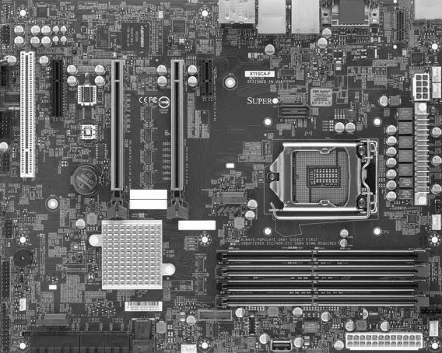
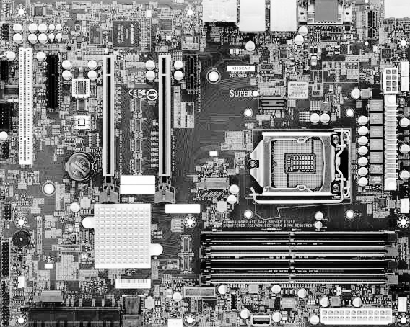
Histogram Equalization

Slide 19
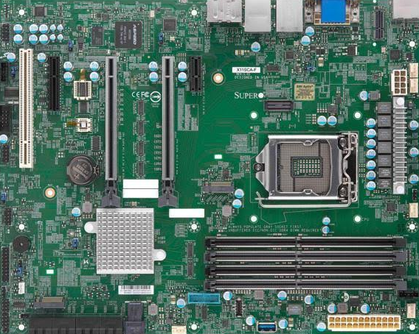
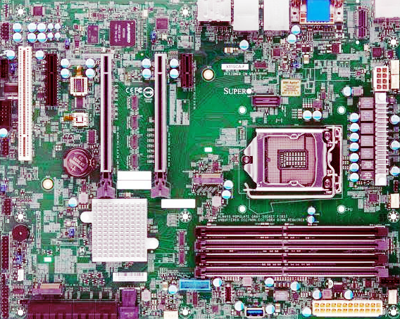
Histogram Equalization

Slide 20
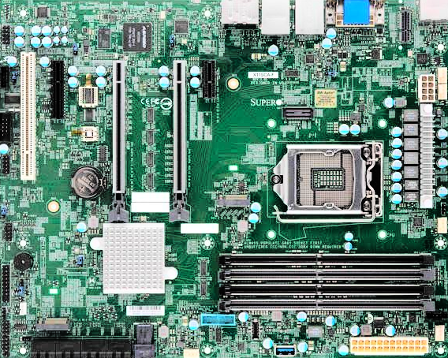
Histogram Equalization

Slide 21
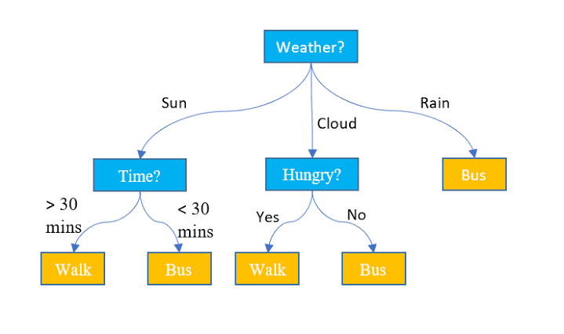

Image Smoothing

Slide 22
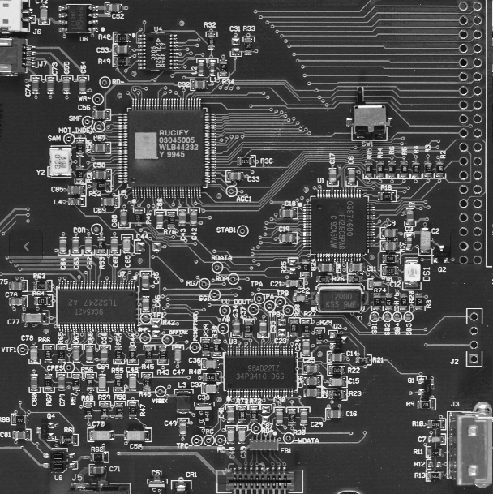
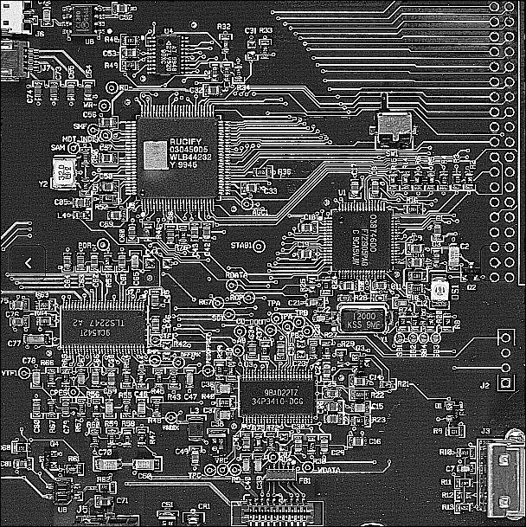
Image Sharpening

Slide 23
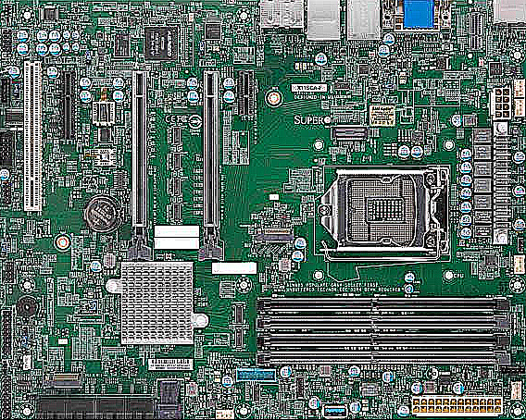
Image Sharpening

Slide 24
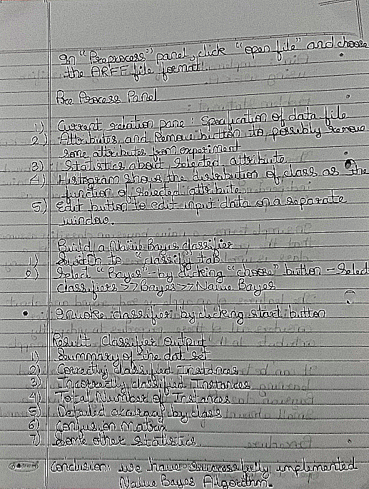
Image Sharpening

Slide 25
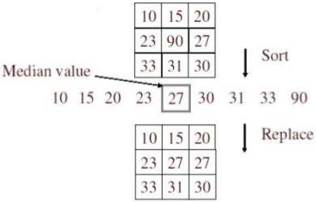
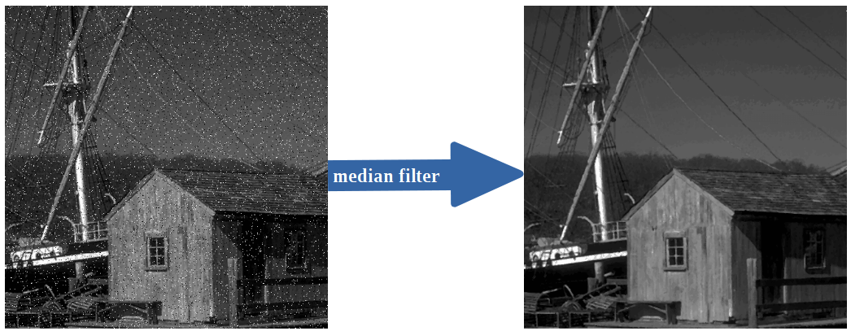
Median Filter

Slide 26
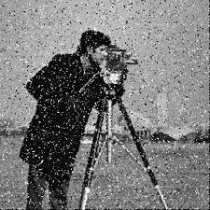

Median Filter

Slide 27
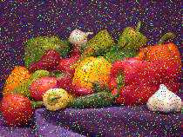

Median Filter

Slide 28
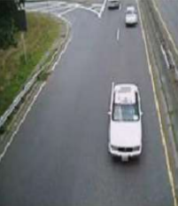
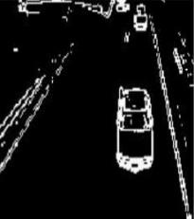
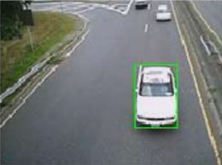
Edge Detection

Slide 29
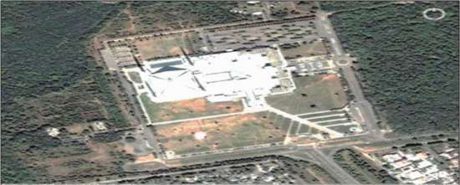
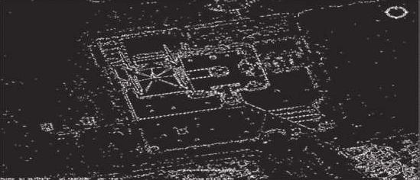
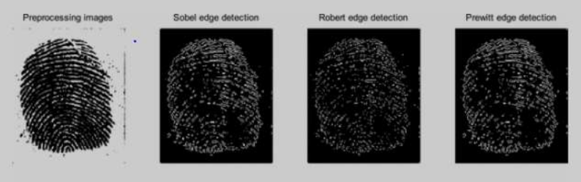
Edge Detection

Slide 30
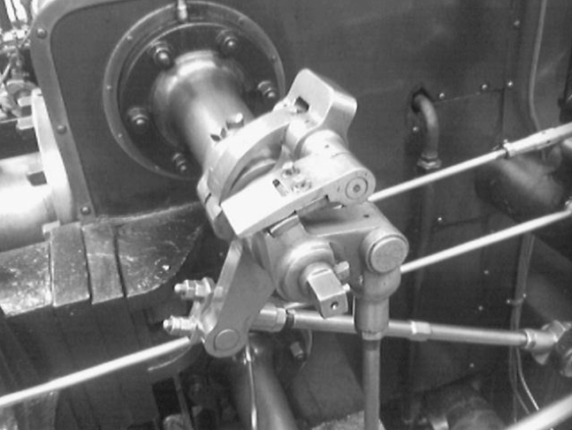
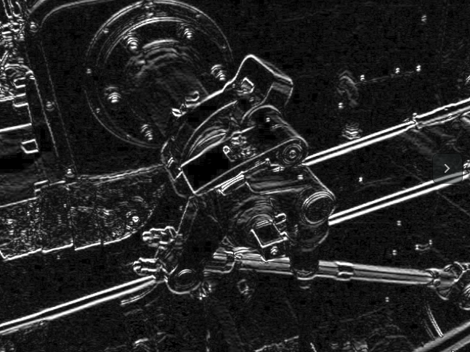
Edge Detection

Slide 31
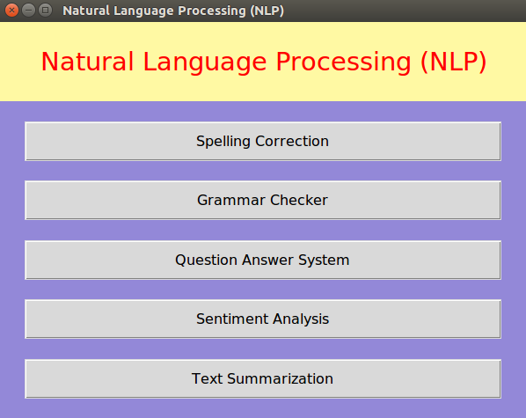
Natural Language Processing (NLP)

Slide 32
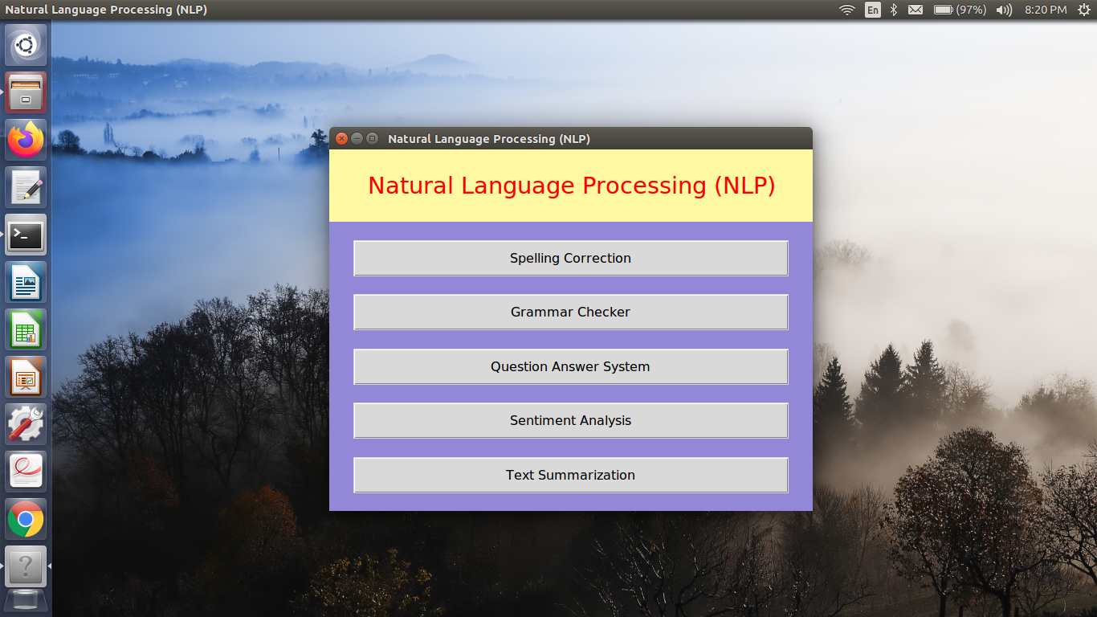
Natural Language Processing (NLP)

Slide 33
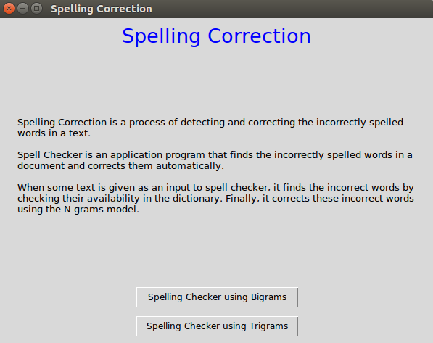
Spelling Correction

Slide 34
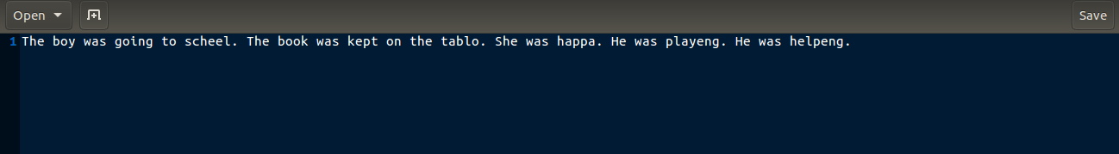
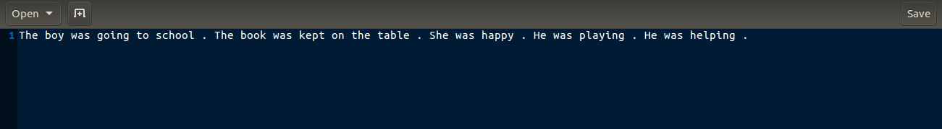
Spelling Correction

Slide 35
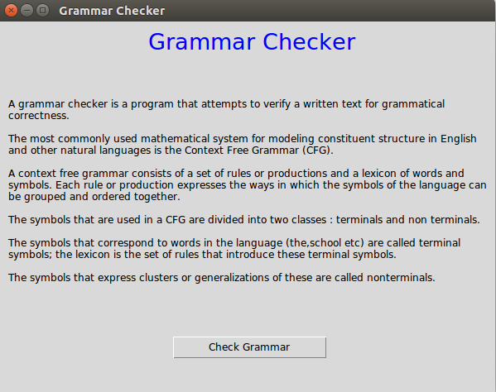
Grammar Checker

Slide 36
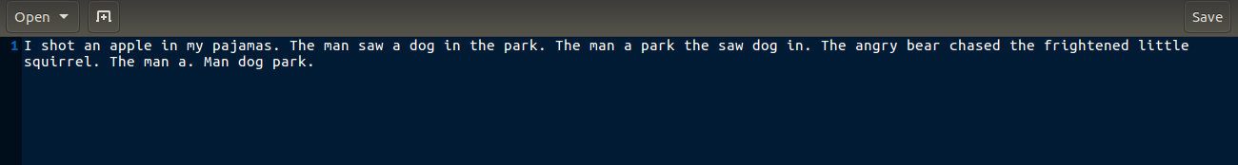
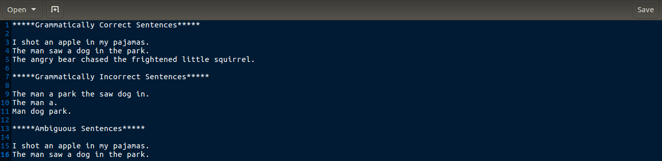
Grammar Checker

Slide 37
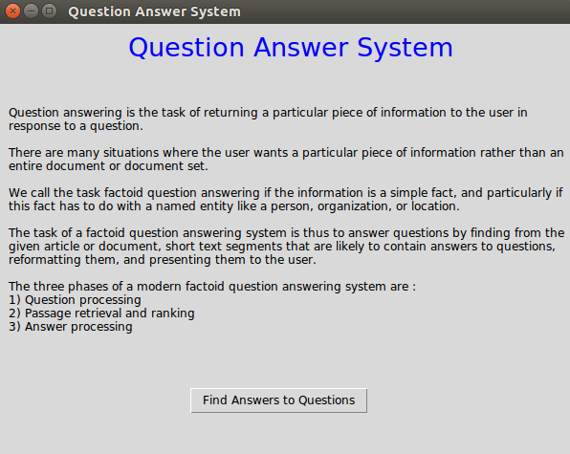
Question Answer System

Slide 38
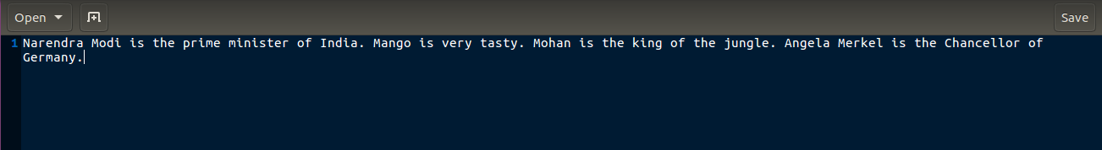
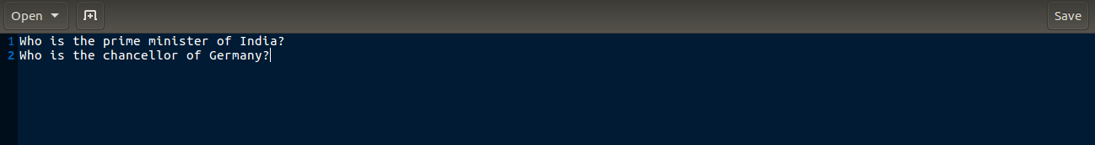
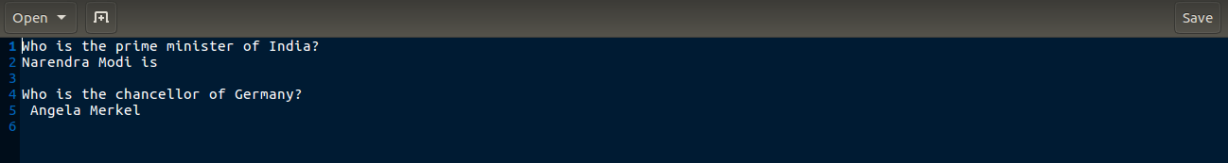
Question Answer System

Slide 39
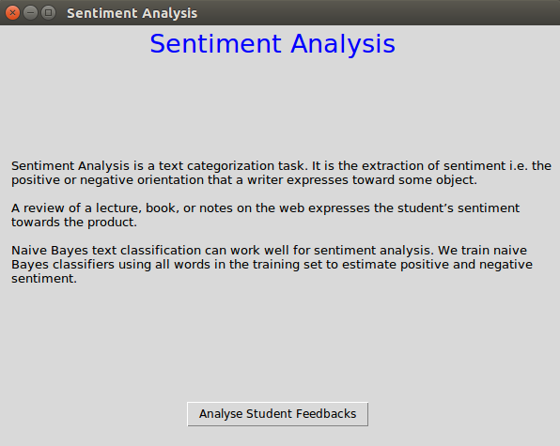
Sentiment Analysis

Slide 40
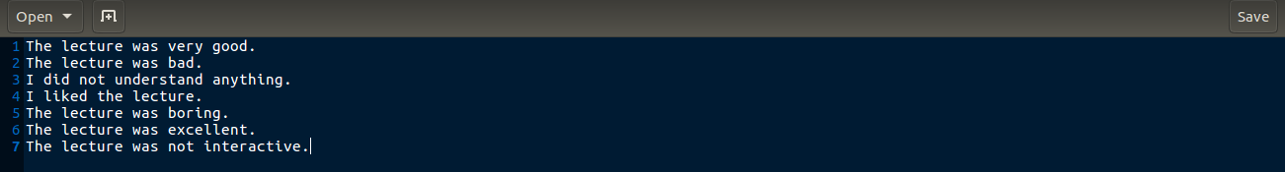
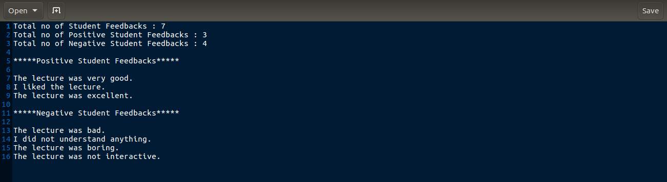
Sentiment Analysis

Slide 41
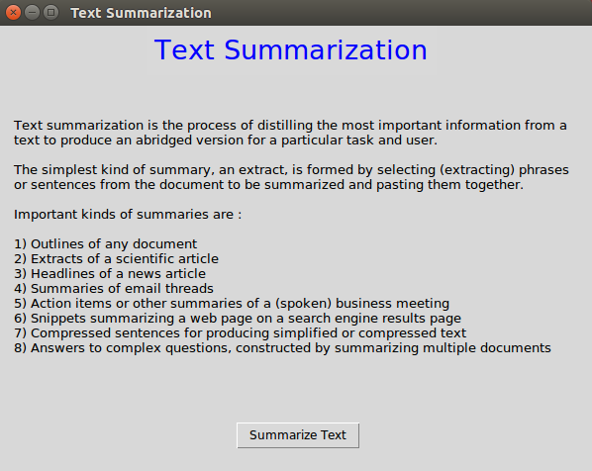
Text Summarization

Slide 42
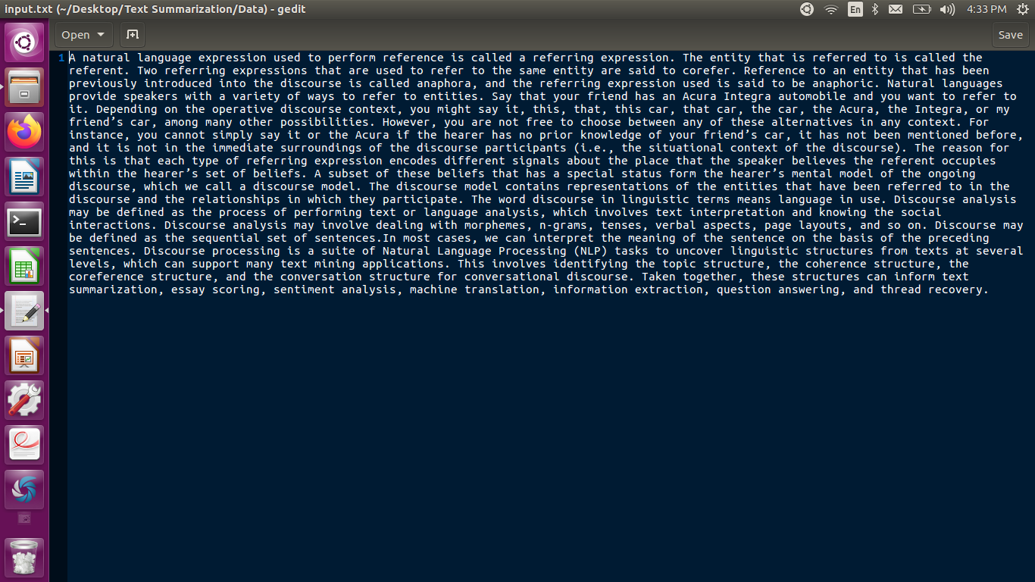
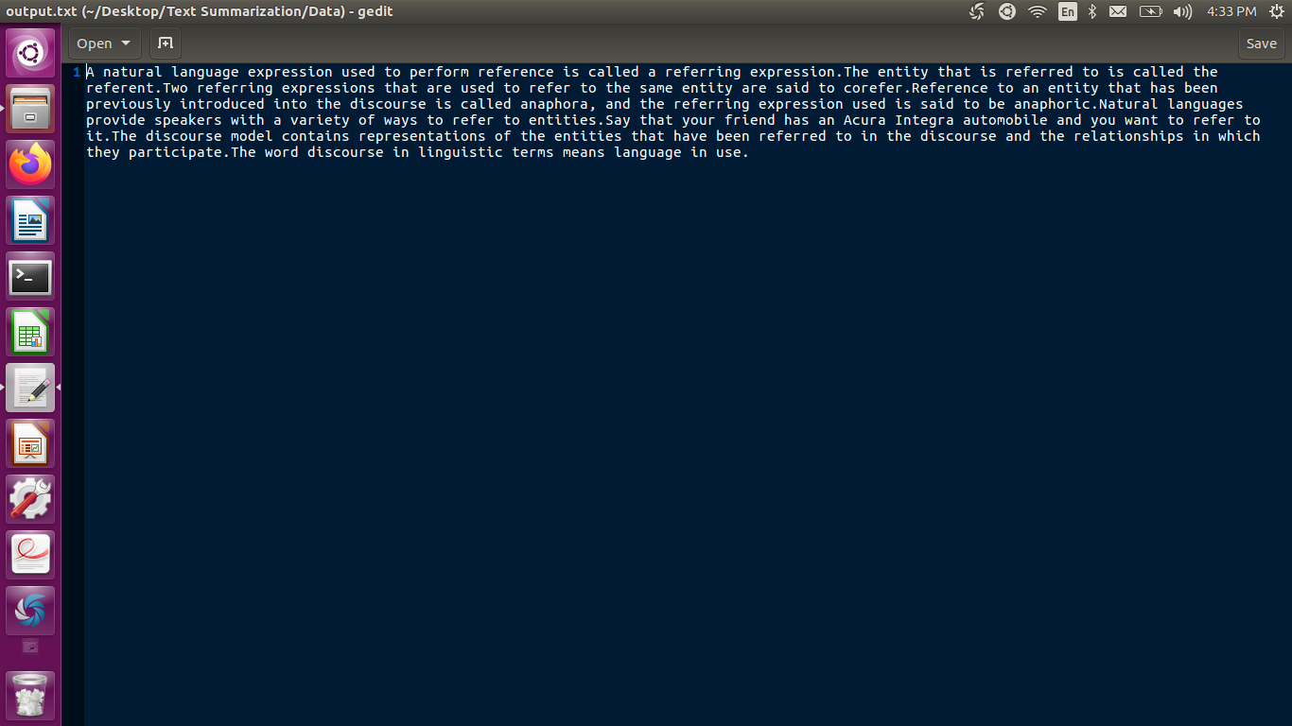
Text Summarization

Slide 43
2.7 References
1) Digital Image Processing by Rafel C. Gonzalez and Richard E. Woods
2) Digital Image Processing by S. Sridhar
3) Speech and Language Processing by Daniel Jurafsky and James H. Martin
4) Foundations of Statistical Natural Language Processing by Christopher Manning and Hinrich Schutze
5) Natural Language Processing with Python by Steven Bird and Ewan Klein
6) Stephen Marsland, “Machine Learning An Algorithmic Perspective” CRC Press
7) Artificial Intelligence A Modern Approach , Stuart J. Russell and Peter Norvig
8) Artificial Intelligence and Intelligent Systems , N.P.Padhy
9) Artificial Intelligence , Elaine Rich and Kevin Knight
10 Tom M.Mitchell “Machine Learning” McGraw Hill
11) Fuzzy Set Theory and its Applications , Zimmermann
12) Introduction to soft computing , Samir Roy and Chakraborty
13) Principles of Soft Computing , S.N.Sivanandam, S.N.Deepa

Slide 44
Thank You

